Slide 1
Software Security

Slide 2
Security problems in programs and programming
Security failures can result from intentional or non-malicious causes; both can cause harm
An error, in performing some software activity, the error may lead to a fault, or an incorrect step, command, process, or data definition in a computer program, design, or documentation.
A failure is a departure from the system’s required behavior.
Security Engineers use flaw to describe both faults and failures.
Program flaws can have two kinds of security implications: They can cause integrity problems leading to harmful output or action, They offer an opportunity for exploitation by a malicious actor.
Program correctness becomes a security issue as well as a general quality problem
Unintentional (Non-malicious) Programming Oversights

Slide 3
Memory Allocation
Data vs. Instructions
Code and data separated, with the heap growing up toward high addresses and the stack growing down from the high addresses.
The same hex value in the same spot in memory can either be a meaningful data value or a meaningful instruction depending on whether the computer treats it as code or data.

Slide 4
Buffer
Buffer is a temporary data storage area with Limited storage capacity.
Buffer is typically area in the memory that is used to transfer data from one location to another location. It offers RAM to the processes.
When any program is executed it is located into Ram and some memory is temporarily allocated to the program called buffer.

Slide 5
Buffer Overflows
Buffer overflow is an attack that occurs when the amount of data that is submitted his larger than the buffer.
Buffer are the container for data and in Buffer overflow we stuff too much information into the container.
Basically this type of attack is possible due to poor written application code or operating system code.

Slide 6
Buffer Overflows
To protect against buffer overflow attacks program or as well as organization needs to ensure following –
1. Programmer should properly test or handle all the overflow conditions.
2. Organisations should ensure all the operating systems and applications are updated with latest updates, service packs and patches.

Slide 7
Buffer Overflows
Buffer overflow attacks results in–
1. Injection of malicious code
2.Denial of service attack DOS
3. SQL (structured query language) injection: Inserting malicious SQL code into a program or website.
Attackers can take the advantage of this phenomenon by submitting too much data which may cause errors and in some cases enables attackers to execute malicious code in the system.
For example when a program ask for a phone number instead of entering 10 digits needed in the software attacker send 1000 digits followed by command to execute malicious code. Because the software program doesn't have proper error handling mechanism it execute the command

Slide 8
Buffer Overflows
Occur when data is written beyond the space allocated for it, such as a 10th byte in a 9-byte array
In a typical exploitable buffer overflow, an attacker’s inputs are expected to go into regions of memory allocated for data, but those inputs are instead allowed to overwrite memory holding executable code
The trick for an attacker is finding buffer overflow opportunities that lead to overwritten memory being executed, and finding the right code to input
char sample[10];
int i;
for (i=0; i<=9; i++)
sample[i] = ‘A’;
sample[10] = ‘B’;
This is a very simple buffer overflow. Character B is placed in memory that wasn’t allocated by or for this procedure.

Slide 9
Overwriting Memory for Execution
Overwrite the program counter stored in the stack
Overwrite part of the code in low memory, substituting new instructions
Overwrite the program counter and data in the stack so that the program counter points to the stack

Slide 10
Harm from Buffer Overflows
Overwrite:
  Another piece of your program’s data
  An instruction in your program
  Data or code belonging to another program
  Data or code belonging to the operating system
Overwriting a program’s instructions gives attackers that program’s execution privileges
Overwriting operating system instructions gives attackers the operating system’s execution privileges

Slide 11
Overflow Countermeasures Summary
Staying within bounds
  Check lengths before writing
  Confirm that array subscripts are within limits
  Double-check boundary condition code for off-by-one errors
  Limit input to the number of acceptable characters
  Limit programs’ privileges to reduce potential harm
Many languages have overflow protections
Code analyzers can identify many overflow vulnerabilities
Canary values in stack to signal modification

Slide 12
Incomplete Mediation
Mediation means checking: the process of intervening to confirm an actor’s authorization before it takes an intended action.
Verifying that the subject is authorized to perform the operation on an object is called mediation.
Not properly checking or controlling data before allowing it to do something important.
It’s like letting someone into a building without fully checking their ID. You may check some things but miss other important ones.
It is failing to fully check user input, requests, or access rights before taking action.
This can lead to:
Unauthorized access
Data leakage
System compromise

Slide 13
Incomplete Mediation
Linux kernel
  Research has revealed many buffer overflows
  Many of these are due to incomplete mediation
Linux kernel is “good” software since
  Open-source
  Kernel ⎯ written by coding gurus
Tools exist to help find such problems
  But incomplete mediation errors can be subtle
  And tools useful to attackers too!
Part 4⎯ Software Mark Stamp’s Information Security: Principles and Practices by Mark Stamp/ Deven Shah.
Copyright © 2009 Wiley India Pvt. Ltd. All rights reserved.

Slide 14
Incomplete Mediation
Validate All Input
Guard Against Users’ Fingers
  There is no reason to leave sensitive data under control of an untrusted user.

Slide 15
Race Conditions
A race condition means that two processes are competing within the same time interval.
The race affects the integrity or correctness of the computing tasks.
Two devices may submit competing requests to the operating system for a given chunk of memory at the same time.
In the two-step request process, each device first asks if the size chunk is available,
if the answer is yes, then reserves that chunk for itself.
Depending on the timing of the steps, the first device could ask for the chunk, get a “yes” answer,
Do not get the chunk because it has already been assigned to the second device.
The two requesters “race” to obtain a resource.

Slide 16
Race Conditions
A race condition occurs most often in an operating system,
It can also occur in multithreaded or cooperating processes.
In a race condition or serialization flaw two processes execute concurrently,
The outcome of the computation depends on the order in which instructions of the processes execute

Slide 17
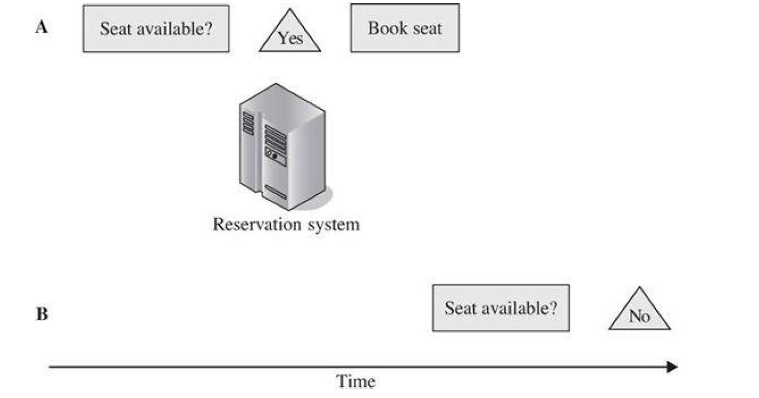
Race Conditions

Slide 18
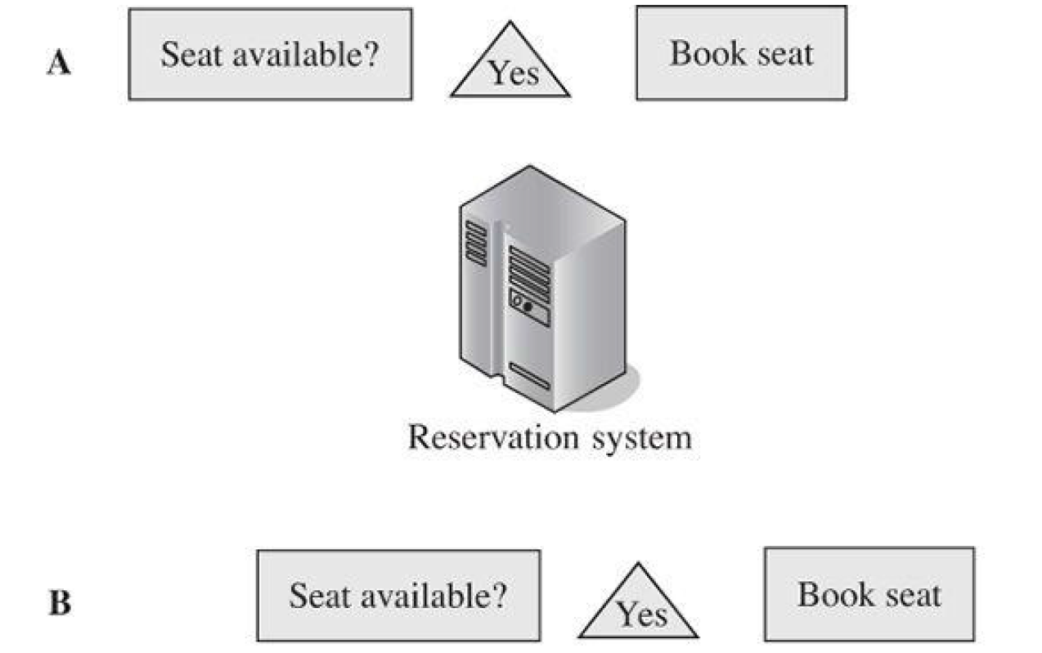
Race Conditions

Slide 19
Race Conditions
Because A has not completed the transaction before the system gets a request from B, the system tells B that the seat is available.
If the system is not designed properly, both agents can complete their transactions, and two passengers will be confirmed for that one seat which will be uncomfortable
A race condition is difficult to detect because it depends on the order in which two processes execute.
The execution order of the processes can depend on many other things, such as the total load on the system,
the amount of available memory space,
the priority of each process, or
the number and timing of system interrupts to the processes.
During testing, and even for a long period of execution, conditions may never cause this particular overload condition to occur.

Slide 20
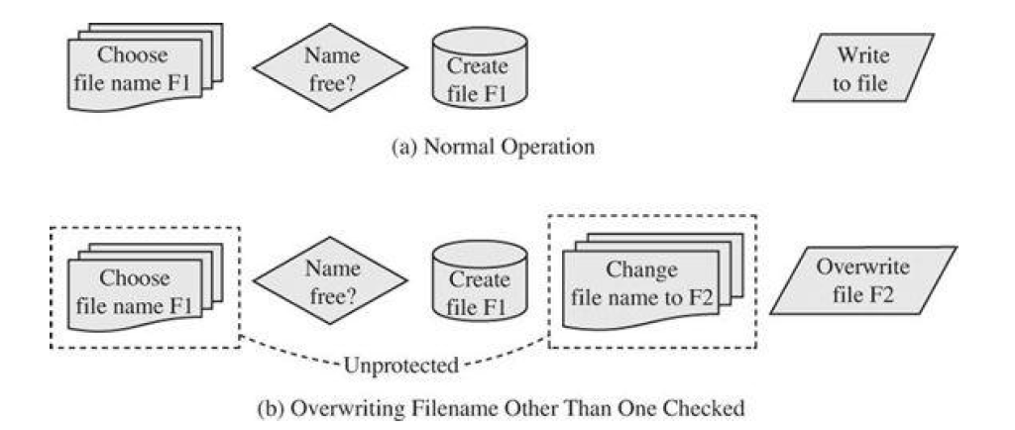
Race Conditions: File Name Race Condition
A race condition between two processes can cause inconsistent, undesired and therefore wrong, outcomes—a failure of integrity.

Slide 21
Race Conditions : File Name Race Condition
Normal Operation (Safe):
Choose file name F1 – The user wants to create or write to a file called F1.
Name free? – The system checks: “Is this file name already used?”
Create file F1 – If the name is free, it creates the file.
Write to file – Now, it writes data into this file.
Abnormal Operation (Unsafe):
Choose file name F1 – Same as before.
Name free? – The system checks if F1 is available.
Create file F1 – System creates file F1.
❗Problem – Before writing data, the attacker changes the file name from F1 to F2 (a different file).
Overwrite file F2 – Now the program writes data into file F2 (which might be important or sensitive), even though the system never checked if F2 was safe to write to!

Slide 22

mkdir Race Condition
mkdir
1. Allocate
space
2. Transfer
ownership
A girl wants to create a folder using mkdir.
Two Steps Involved:
Allocate space: The system receives the request and sets aside space on the disk to make a new folder.
Transfer ownership: After the folder is created, the system gives control (ownership) of that folder back to the user.
Part 4⎯ Software Mark Stamp’s Information Security: Principles and Practices by Mark Stamp/ Deven Shah.
Copyright © 2009 Wiley India Pvt. Ltd. All rights reserved.

Slide 23
mkdir Attack
mkdir
1. Allocate
space
3. Transfer
ownership
What should happen:
System allocates space to create a new folder.
System gives the user ownership of that folder.
2. Create link to
password file
While the system is still working (after step 1 but before step 3):
Step 2: An attacker quickly jumps in
They replace the folder with a link to a sensitive file (like the password file).
This is called a symlink attack or race condition exploit.
What happens next:
Step 3: The system unknowingly gives ownership to the user — but now it’s not the folder, it’s the linked password file!
Part 4⎯ Software Mark Stamp’s Information Security: Principles and Practices by Mark Stamp/ Deven Shah.
Copyright © 2009 Wiley India Pvt. Ltd. All rights reserved.

Slide 24
Race Conditions
Race conditions are common
But race conditions harder to exploit
  Buffer overflow is “low hanging fruit” today
To prevent race conditions, make security-critical processes atomic
  Occur all at once, not in stages
  Not always easy to accomplish in practice
Part 4⎯ Software Mark Stamp’s Information Security: Principles and Practices by Mark Stamp/ Deven Shah.
Copyright © 2009 Wiley India Pvt. Ltd. All rights reserved.

Slide 25
Malware
Programs planted by an agent with malicious intent to cause unanticipated or undesired effects
Virus
  A program that can replicate itself and pass on malicious code to other nonmalicious programs by modifying them.
  Code with malicious purpose; intended to spread.
Worm
  A program that spreads copies of itself through a network
Trojan horse
  program with benign apparent effect but second, hidden, malicious effect
  Code/software that appear to do one thing but has some unexpected functionality

Slide 26
Malwares
To remember the differences among these three types of malware:
Trojan horse is on the surface a useful program with extra, undocumented (malicious) features. It does not necessarily try to propagate.
By contrast, a virus is a malicious program that attempts to spread to other computers, as well as perhaps performing unpleasant action on its current host. The virus does not necessarily spread by using a network’s properties; it can be spread instead by traveling on a document transferred by a portable device (that memory stick you just inserted in your laptop!) or triggered to spread to other, similar file types when a file is opened.
However, a worm requires a network for its attempts to spread itself elsewhere.

Slide 27
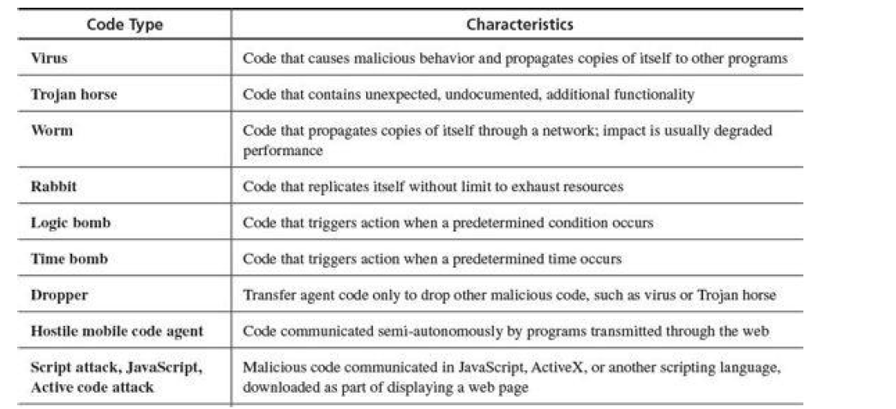
Types of Malware

Slide 28
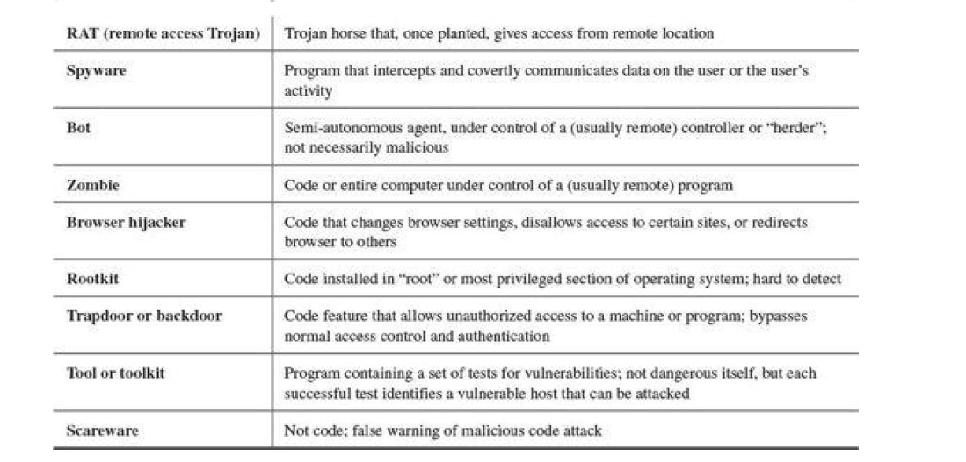
Types of Malware

Slide 29
Harm from Malicious Code
Harm to users and systems:
  Sending email to user contacts
  Deleting or encrypting files
  Modifying system information, such as the Windows registry
  Stealing sensitive information, such as passwords
  Attaching to critical system files
  Hide copies of malware in multiple complementary locations
Harm to the world:
  Some malware has been known to infect millions of systems, growing at a geometric rate
  Infected systems often become staging areas for new infections

Slide 30
Malware Detection
Three common methods
  Signature detection
  Change detection
  Anomaly detection
We’ll briefly discuss each of these
  And consider advantages and disadvantages of each
Part 4⎯ Software Mark Stamp’s Information Security: Principles and Practices by Mark Stamp/ Deven Shah.
Copyright © 2009 Wiley India Pvt. Ltd. All rights reserved.

Slide 31
Signature Detection
This method looks for known patterns (signatures) of malware. Each virus or malware has a unique code pattern, like a fingerprint.
Antivirus software compares files and programs to a database of known malware signatures. If it finds a match, it flags it as malware.
Example:
Detecting a virus that has already been seen and recorded, like a famous Trojan.
Pros:
Fast and accurate for known threats
Widely used in antivirus tools
Cons:
Can’t detect new or unknown malware
Needs regular updates of the signature database

Slide 32
Signature Detection
A signature is a string of bits found in software (or could be a hash value)
Suppose that a virus has signature 0x23956a58bd910345
We can search for this signature in all files
If we find the signature are we sure we’ve found the virus?
  No, same signature could appear in other files
  But at random, chance is very small: 1/2⁶⁴
  Software is not random, so probability is higher
Part 4⎯ Software Mark Stamp’s Information Security: Principles and Practices by Mark Stamp/ Deven Shah.
Copyright © 2009 Wiley India Pvt. Ltd. All rights reserved.

Slide 33
Signature Detection
Advantages
  Effective on “traditional” malware
  Minimal burden for users/administrators
Disadvantages
  Signature file can be large (10,000’s)…
  …making scanning slow
  Signature files must be kept up to date
  Cannot detect unknown viruses
  Cannot detect some new types of malware
By far the most popular detection method
Part 4⎯ Software Mark Stamp’s Information Security: Principles and Practices by Mark Stamp/ Deven Shah.
Copyright © 2009 Wiley India Pvt. Ltd. All rights reserved.

Slide 34
Change Detection
This method watches for unauthorized or unexpected changes in system files, settings, or programs.
It takes a “snapshot” of files and system state. Later, it checks again to see if anything has been altered.
Example:
If a malware silently modifies a system file, this method will detect that change.
Pros:
Good for spotting unauthorized tampering
Doesn’t need to know the malware in advance
Cons:
Can trigger alerts for legitimate changes
May not tell you what exactly changed

Slide 35
Change Detection
Viruses must live somewhere on system
If we detect that a file has changed, it may be infected
How to detect changes?
  Hash files and (securely) store hash values
  Recompute hashes and compare
  If hash value changes, file might be infected
  Check for Oligomorphism or polymorphism

Slide 36
Change Detection
Advantages
  Virtually no false negatives
  Can even detect previously unknown malware
Disadvantages
  Many files change ⎯ and often
  Many false alarms (false positives)
  Heavy burden on users/administrators
  If suspicious change detected, then what?
  Might still need signature-based system
Part 4⎯ Software Mark Stamp’s Information Security: Principles and Practices by Mark Stamp/ Deven Shah.
Copyright © 2009 Wiley India Pvt. Ltd. All rights reserved.

Slide 37
Anomaly Detection
This method looks for unusual behavior in a system that doesn’t match the normal pattern.
It builds a model of what’s “normal” for the system (like typical CPU use, file access, or network traffic). Anything very different is treated as a potential threat.
Example:
A program suddenly trying to send a lot of data to an unknown server might be flagged as malware.
Pros:
Can detect new, unknown, or hidden malware
Useful for advanced and evolving threats
Cons:
May give false alarms
Needs time to learn what “normal” looks like

Slide 38
Anomaly Detection
Monitor system for anything “unusual” or “virus-like” or potentially malicious
What is unusual?
  Files change in some unusual way
  System misbehaves in some way
  Unusual network activity
  Unusual file access, etc., etc., etc.
But must first define “normal”
  And normal can change!
Part 4⎯ Software Mark Stamp’s Information Security: Principles and Practices by Mark Stamp/ Deven Shah.
Copyright © 2009 Wiley India Pvt. Ltd. All rights reserved.

Slide 39
Anomaly Detection
Advantages
  Chance of detecting unknown malware
Disadvantages
  Unproven in practice
  Trudy can make abnormal look normal (go slow)
  Must be combined with another method (such as signature detection)
Also popular in intrusion detection (IDS)
A difficult unsolved (unsolvable?) problem
  As difficult as AI?
Part 4⎯ Software Mark Stamp’s Information Security: Principles and Practices by Mark Stamp/ Deven Shah.
Copyright © 2009 Wiley India Pvt. Ltd. All rights reserved.

Slide 40
Countermeasures for Users
Use software acquired from reliable sources
Test software in an isolated environment
Only open attachments when you know them to be safe
Treat every website as potentially harmful
Make a recoverable system image and store it safely.
Create and maintain backups / Make and retain backup copies of executable system files
Use of virus detectors

Slide 41
Countermeasures for Users : User Vigilance
Users should be alert and cautious while using computers and the internet.
Don’t open unknown email attachments or suspicious links.
Avoid downloading software from untrusted websites.
Be careful while using USB drives from others.
Always read warnings from your antivirus or system.
Most malware infections happen because users accidentally allow it in. Awareness is the first line of defence.

Slide 42
Countermeasures for Users : Virus Detectors (Antivirus Software)
Software designed to find and remove malware from your device.
It works as follows:
Scans files and programs regularly.
Alerts you if it finds suspicious behavior or known viruses.
Offers real-time protection while browsing or downloading.
It provides automatic protection and detects many threats before they can cause damage.

Slide 43
Countermeasures for Users : Virus Signatures
These are unique patterns or code fragments that identify known viruses.
It works as follows:
Antivirus software compares files to a database of virus signatures.
If a match is found, it flags the file as infected.
It is a quick and reliable way to detect known viruses.

Slide 44
Countermeasures for Users : Code Analysis
This involves analyzing how a program behaves or what its code does before letting it run.
Types:
Static analysis – Looks at the code without running it.
Dynamic analysis – Observes the program while it runs.
Helps catch malware that tries to hide or disguise itself, even if it has no known signature.

Slide 45
Countermeasures for Users : Storage Patterns
Monitoring how data is stored or changed in the system to spot unusual activity.
It works as follows:
Looks for strange file locations, hidden files, or changes to system folders.
Some malware tries to store itself in sneaky places.
Detects malware based on how and where it hides, not just what it looks like.

Slide 46
Countermeasures for Developers : Software Engg Techniques
Code usually has a long shelf-life and is enhanced over time as needs change and faults are found and fixed.
For this reason, a key principle of software engineering is to create a design or code in small, self-contained units, called components or modules; when a system is written this way, we say that it is modular. Modularity offers advantages for program development in general and security in particular.
If a component is isolated from the effects of other components, then the system is designed in a way that limits the damage any fault causes. Maintaining the system is easier because any problem that arises connects with the fault that caused it. Testing is simpler, since changes to an isolated component do not affect other components. And developers can readily see where vulnerabilities may lie if the component is isolated. We call this isolation encapsulation.

Slide 47
Countermeasures for Developers : Software Engg Techniques
Code usually has a long shelf-life and is enhanced over time as needs change and faults are found and fixed.
For this reason, a key principle of software engineering is to create a design or code in small, self-contained units, called components or modules; when a system is written this way, we say that it is modular. Modularity offers advantages for program development in general and security in particular.
If a component is isolated from the effects of other components, then the system is designed in a way that limits the damage any fault causes. Maintaining the system is easier because any problem that arises connects with the fault that caused it. Testing is simpler, since changes to an isolated component do not affect other components. And developers can readily see where vulnerabilities may lie if the component is isolated. We call this isolation encapsulation.

Slide 48
Countermeasures for Developers : Software Engg Techniques
Information hiding is another characteristic of modular software. When information is hidden, each component hides its precise implementation or some other design decision from the others.
Thus, when a change is needed, the overall design can remain intact while only the necessary changes are made to particular components.

Slide 49
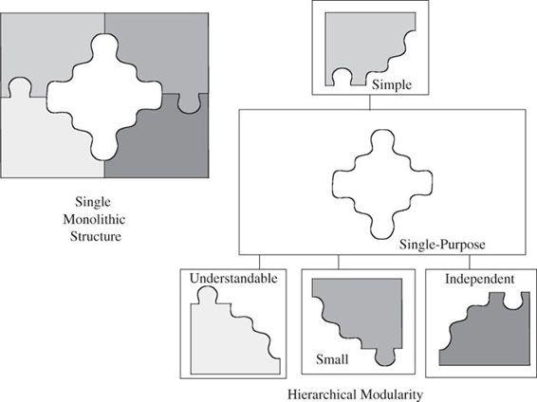
Countermeasures for Developers : Modularity
Modularization is the process of dividing a task into subtasks, as depicted in Figure. This division is usually done on a logical or functional basis, so that each component performs a separate, independent part of the task.
The goal is for each component to meet four conditions:
• single-purpose, performs one function
• small, consists of an amount of information for which a human can readily
grasp both structure and content
• simple, is of a low degree of complexity so that a human can readily
understand the purpose and structure of the module
• independent, performs a task isolated from other modules

Slide 50
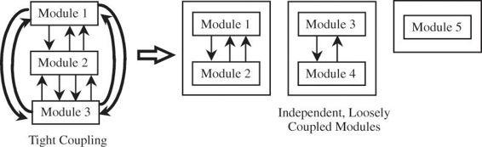
Countermeasures for Developers : Coupling
Coupling refers to the degree with which a component depends on other components in the system.
Thus, low or loose coupling is better than high or tight coupling because the loosely coupled components are free from unwitting interference from other components.
Types of Coupling

Slide 51
Countermeasures for Developers : Encapsulation
Encapsulation hides a component’s implementation details, but it does not necessarily mean complete isolation. Many components must share information with other components, usually with good reason.
However, this sharing is carefully documented so that a component is affected only in known ways by other components in the system. Sharing is minimized so that the fewest interfaces possible are used.

Slide 52
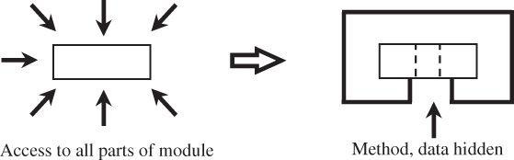
Countermeasures for Developers : Information Hiding
Information Hiding: describing what a module does, not how
Developers who work where modularization is stressed can be sure that other components will have limited effect on the ones they write.
Thus, we can think of a component as a kind of black box, with certain well-defined inputs and outputs and a welldefined function.
Other components’ designers do not need to know how the module completes its function; it is enough to be assured that the component performs its task in some correct manner.

Slide 53
Countermeasures for Developers : Mutual Suspicion
The concept of mutual suspicion to describe the relationship between two programs.
Mutually suspicious programs operate as if other routines in the system were malicious or incorrect.
A calling program cannot trust its called subprocedures to be correct, and a called subprocedure cannot trust its calling program to be correct.
Each protects its interface data so that the other has only limited access.
For example, a procedure to sort the entries in a list cannot be trusted not to modify those elements, while that procedure cannot trust its caller to provide any list at all or to supply the number of elements predicted.

Slide 54
Countermeasures for Developers : Confinement
Confinement (means kept within limits) is a technique used by an operating system on a suspected program to help ensure that possible damage does not spread to other parts of a system.
A confined program is strictly limited in what system resources it can access.
If a program is not trustworthy, the data it can access are strictly limited.
Strong confinement would be particularly helpful in limiting the spread of viruses.
Therefore, the virus can spread only to things in that compartment; it cannot get outside
the compartment.

Slide 55
Countermeasures for Developers : Simplicity
The case for simplicity—of both design and implementation—should be self-evident:
simple solutions are easier to understand, leave less room for error, and are easier to
review for faults.
With a simple design, all members of the design and implementation team can understand the role and scope of each element of the design, so each participant knows not only what to expect others to do but also what others expect. Perhaps the worst problem of a running system is maintenance: After a system has been running for some time, and the designers and programmers are working on other projects (or perhaps even at other companies), a fault appears and some unlucky junior staff member is assigned the task of correcting the fault. With no background on the project, this staff member must attempt to intuit the visions of the original designers and understand the entire context of the flaw well enough to fix it. A simple design and implementation facilitates correct maintenance.

Slide 56
Countermeasures for Developers : Genetic Diversity
At your local electronics shop you can buy a combination printer–scanner–copier–fax machine. It comes at a good price (compared to costs of buying the four components separately) because there is considerable overlap in implementing the functionality among those four. Moreover, the multifunction device is compact, and you need install only one device on your system, not four. But if any part of it fails, you lose a lot of capabilities all at once. So the multipurpose machine represents the kinds of trade-offs among functionality, economy, and availability that we make in any system design.
When designing computer systems or devices, people often think about making them in a smart way — like using modules (separate parts), hiding inner details, and reusing parts easily.
Because of these good design ideas, some experts suggest that systems should have variety — like using parts from different makers or sources, not just one. This idea is called heterogeneity or genetic diversity in system design.
Why?
If all parts come from the same place or you depend too much on one part, it can be risky.
If that part fails or has a problem, the whole system could stop working.
So, using different types of parts or components (just like having genetic diversity in nature) can make the system safer, stronger, and more flexible.

Slide 57
Countermeasures for Developers : Testing
Testing is a process activity that concentrates on product quality: It seeks to locate potential product failures before they actually occur. The goal of testing is to make the product failure free (eliminating the possibility of failure). The failure of one control may expose a vulnerability.
Testers improve software quality by finding as many faults as possible and carefully documenting their findings so that developers can locate the causes and repair the problems if possible.

Slide 58
Countermeasures for Developers :Testing: ‘Types of Testing’
Testing usually involves several stages.
Module testing, component testing, or unit testing : First, each program component is tested on its own. Such testing, known as, module testing, component testing, or unit testing . It verifies that the component functions properly with the types of input expected from a study of the component’s design. Unit testing is done so that the test team can feed a predetermined set of data to the component being tested and observe what output actions and data are produced.
Integration testing: When collections of components have been subjected to unit testing, the next step is ensuring that the interfaces among the components are defined and handled properly. Indeed, interface mismatch can be a significant security vulnerability, so the interface design is often documented as an application programming interface or API.\
Integration testing is the process of verifying that the system components work together
as described in the system and program design specifications.

Slide 59
Countermeasures for Developers :Testing: ‘Types of Testing’
Testing usually involves several stages
A function test evaluates the system to determine whether the functions described by the requirements specification are actually performed by the integrated system. The result is a functioning system. The function test compares the system being built with the functions described in the developers’ requirements specification.
Performance test: It compares the system with the remainder of these software and hardware requirements.
During the function and performance tests, testers examine security requirements and confirm that the system is as secure as it is required to be.

Slide 60
Countermeasures for Developers :Testing: ‘Types of Testing’
Testing usually involves several stages
Acceptance test: In this test the system is checked against the customer’s requirements description. Upon completion of acceptance testing, the accepted system is installed in the environment in which it will be used.
Installation test: A final installation test is run to make sure that the system still functions as it
should. However, security requirements often state that a system should not do something.
Regression testing: System testing has a very different objective: to ensure that the system does what the customer wants it to do. Regression testing, an aspect of system testing, is particularly important for security purposes. After a change is made to enhance the system or fix a problem, regression testing ensures that all remaining functions are still working and that performance has not been degraded by the change.

Slide 61
Countermeasures for Developers :Testing: ‘Types of Testing’
Testing usually involves several stages
Black-box testing: It treats a system or its components as black boxes; testers cannot “see inside” the system, so they apply particular inputs and verify that they get the expected output.
Clear-box testing: It allows visibility. Here, testers can examine the design and code directly, generating test cases based on the code’s actual construction.
Who does the testing?
From a security standpoint, independent testing is highly desirable; it may prevent a developer from attempting to hide something in a routine or keep a subsystem from controlling the tests that will be applied to it. Thus, independent testing increases the likelihood that a test will expose the effect of a hidden feature.

Slide 62
Countermeasures for Developers
Software Engineering Techniques Modularity and encapsulation
Information hiding - Information hiding: describing what a module does, not how
Modularity – Coupling and cohesion
Mutual Suspicion
Confinement - possible damage does not spread to other parts of a system
Simplicity - Complexity is often the enemy of security
Genetic Diversity - Diversity reduces the number of targets susceptible to one attack type
Testing

Slide 63
Code Testing
Unit testing checks if software components are fulfilling functionalities or not.
Integration testing checks the data flow from one module to other modules.
Function testing seeks to establish whether each application feature works as per the software requirements.
Performance testing evaluates the speed, responsiveness and stability of a computer, network, software program or device under a workload.
Acceptance testing checks the requirements of a specification or contract are met as per its delivery.
Installation testing verifies the software’s installation process and ensures that the software is installed correctly on various systems and configurations.
Regression testing makes sure that everything else still works when you make a corrective change
Penetration testing is security testing a cyber-security expert attempts to find and exploit vulnerabilities in a computer system

Slide 64
Countermeasure Specifically for Security – Design Principles for Security
Penetration Testing for Security
Proofs of Program Correctness
Validation
Defensive Programming - Program designers and implementers need not only write correct code but must also anticipate what could go wrong.
Trustworthy Computing Initiative - all developers undergo security training, and secure software development practices were instituted throughout the company

Slide 65
Countermeasure Specifically for Security – Design Principles for Security
Multics (MULTiplexed Information and Computer Service) was a major secure software project intended to provide a computing utility to its users, much as we access electricity or water.
The system vision involved users who could effortlessly connect to it, use the computing services they needed, and then disconnect—much as we turn the tap on and off.
Clearly all three fundamental goals of computer security—confidentiality, integrity, and availability—are necessary for such a widely shared endeavor, and security was a major objective for the three participating Multics partners: M.I.T, AT&T Bell Laboratories, and GE.

Slide 66
Countermeasure Specifically for Security – Penetration Testing for Security
Penetration testing or tiger team analysis is a strategy often used in computer security. Sometimes it is called ethical hacking, because it involves the use of a team of experts trying to crack the system being tested (as opposed to trying to break into the system for unethical reasons). The work of penetration testers closely resembles what an actual attacker might do The tiger team knows well the typical vulnerabilities in operating systems.
Penetration testing is both an art and science. The artistic side requires careful analysis and creativity in choosing the test cases.
But the scientific side requires rigor, order, precision, and organization.

Slide 67
Countermeasure Specifically for Security – Proofs of Program Correctness
A security expert wants to make sure that:
A program gives the correct result,
It does the right job,
And it doesn't do anything extra or harmful.
But there's a big problem in computer science:
We cannot always be 100% sure that two different programs do exactly the same thing.
This is because of something called the "halting problem.“
The halting problem says:
There's no general way to check if any program will finish running (halt) for every input, or if it will get stuck and run forever. Because of this, we also can’t create a perfect method to check if two programs always behave the same.
In short:
We want to prove that programs work exactly right and do nothing wrong — but computer science shows it's impossible to be completely sure in every case.

Slide 68
Countermeasure Specifically for Security – Validation
Formal verification is a particular instance of the more general approach to assuring correctness. There are many ways to show that each of a system’s functions works correctly.
Validation is the counterpart to verification, assuring that the system developers have implemented all requirements. Thus, validation makes sure that the developer is building the right product (according to the specification), and verification checks the quality of the implementation.

Slide 69
Countermeasure Specifically for Security – Defensive Programming
The aphorism “offense sells tickets; defense wins championships”
Scoring points (offense) is exciting and fun to watch, so it attracts fans.
But stopping the other team from scoring (defense) is what actually helps you win important games or championships.
Looking good (with flashy moves) can impress people, but doing the hard, smart work (like defense) is what brings true success.
Regardless of its origin, the aphorism has a certain relevance to computer security as well.
As we have already shown, the world s generally aggressive: Defenders have to counter all possible attacks, whereas attackers have only to find one weakness to exploit. Thus, a strong defense is not only helpful, it is essential. Program designers and implementers need not only write correct code but must also anticipate what could go wrong.

Slide 70
Countermeasure Specifically for Security – Trustworthy Computing Initiative
The Trustworthy Computing Initiative was a program started by Microsoft in 2002 to make computers and software more secure, private, reliable, and easy to use.
It was Microsoft’s big promise to put security, safety, and user trust first when designing and updating their products, so people could feel confident that their computers wouldn’t easily get hacked, crash, or misuse their personal data.
Microsoft had a serious problem with code quality in 2002.
Flaws in its products appeared frequently, and it released patches as quickly as it could. But the sporadic (irregular) nature of patch releases confused users and made the problem seem worse than it was.

Slide 71
Countermeasure Specifically for Security – Design by Contract or Programming by Contract
Design by contract (also called programming by contract) is a way of writing programs that helps find and prevent errors.
The idea is to treat each part of a program (a “module”) like it has a contract with the rest of the program. This contract clearly states:
Preconditions and Postconditions are conditions necessary (expected, required, or enforced) to be true before the module begins and after it ends, respectively.
Invariants are conditions necessary to be true throughout the module’s execution.

Slide 72
Countermeasure Specifically for Security –
Design Principles for Security
Least privilege
Economy of mechanism
Open design
Complete mediation
Permission based
Separation of privilege
Least common mechanism
Ease of use

Slide 73
Countermeasure Specifically for Security –
Design Principles for Security
Penetration Testing for Security
Proofs of Program Correctness
Validation
Defensive Programming - Program designers and implementers need not only write correct code but must also anticipate what could go wrong.
Trustworthy Computing Initiative - all developers undergo security training, and secure software development practices were instituted throughout the company

Slide 74
Countermeasures that Don’t Work: Penetrate-and-Patch
"Penetrate-and-patch" refers to a software security approach where vulnerabilities are identified through attempts to exploit them (penetrate), and then fixed (patched) after they are found. This reactive method, while common, is generally considered less effective than a proactive, security-focused development lifecycle.
It has two problems:
People think the best way to test a computer system is to bring in a group of skilled hackers to try to break it.
If these hackers can’t find any problems, people wrongly believe the system must be safe.
Penetrate-and-patch fails because it is hurried, misses the context of the fault, and focuses on one failure, not the complete system.

Slide 75
Countermeasures that Don’t Work: Security by Obscurity
Computer security experts use the term security by or through obscurity (hard to understand) to describe the ineffective countermeasure of assuming the attacker will not find a vulnerability.
Security by obscurity is the belief that a system can be secure as long as nobody outside its implementation group is told anything about its internal mechanisms. Hiding account passwords in binary files or scripts with the presumption that nobody will ever find them is a prime case.

Slide 76
Countermeasures that Don’t Work
Penetrate-and-Patch - Penetrate-and-patch fails because it is hurried, misses the context of the fault, and focuses on one failure, not the complete system.
Security by Obscurity - Security by obscurity is the belief that a system can be secure as long as nobody outside its implementation group is told anything about its internal mechanisms.

Slide 77
Summary
Buffer overflow attacks can take advantage of the fact that code and data are stored in the same memory in order to maliciously modify executing programs
Programs can have a number of other types of vulnerabilities, including off-by-one errors, incomplete mediation, and race conditions
Malware can have a variety of harmful effects depending on its characteristics, including resource usage, infection vector, and payload
Developers can use a variety of techniques for writing and testing code for security

